Slide 1
PRIVATE PROMOTION REQUIREMENTS
Cadet Name (last, first): ______________________________ Company: _____________
Task: Date Completed: Certified By (rank & name):
Recite the JROTC “Mission” ______________ ______________________
Recite the “JROTC Creed” ______________ ______________________
Recite the “7 Army Values” ______________ ______________________
Score 100% on Rank Test ______________ ______________________
Recite Chain of Command ______________ ______________________
PSG: _____________________ 1SG: ____________________ CDR: ___________________
SAI / AI Verifies or Waives the Following: _________________________________
Grade of 80 % or Higher in JROTC
No ISS/OSS within the First Semester
No Missed Uniform Wears in last 8 Inspections

Slide 2
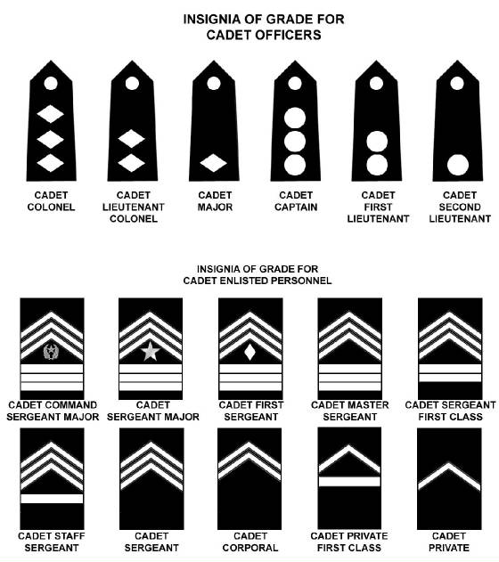
JROTC Creed
I am an Army Junior ROTC Cadet.
I will always conduct myself to bring credit to my family, country, school and the Corps of Cadets.
I am loyal and patriotic.
I am the future of the United States of America.
I do not lie, cheat or steal and will always be accountable for my actions and deeds.
I will always practice good citizenship and patriotism.
I will work hard to improve my mind and strengthen my body.
I will seek the mantle of leadership and stand prepared to uphold the Constitution and the American way of life.
May God grant me the strength to always live by this creed.
Cadet Chain of Command
Commander in Chief: _________________________________
Secretary of Defense: _________________________________
Secretary of the Army: _________________________________
Chief of Staff in the Army: _________________________________
Commanding General, TRADOC: _________________________________
Commanding General, Cadet Command: _________________________________
Commander, 6th ROTC Brigade: _________________________________
SAI: _________________________________
Sergeant Major of the Army: _________________________________
Command Sergeant Major, TRADOC: _________________________________
Command Sergeant Major, Cadet Command: _________________________________
Command Sergeant Mjor, 6th
Army JROTC
MISSION: “To motivate young people to be better citizens.”
7 Army Values
Loyalty
Duty
Respect
Selfless Service
Honor
Integrity
Personal Courage

Slide 3
PVT TO PFC PROMOTION REQUIREMENTS
Cadet Name (last, first): ______________________________ Company: _____________
Task: Date Completed: Certified By (rank & name):
Recertify E1 to E2 Knowledge ______________ ______________________
Answer LET Knowledge Questions ______________ ______________________
Fold U.S. flag ______________ ______________________
Perform Basic Drill Movements ______________ ______________________
Attend 1 BN Out of School Activity ______________ ______________________
PSG: _____________________ 1SG: ____________________ CDR: ___________________
SAI / AI Verifies or Waives the Following: _________________________________
Passing JROTC
No ISS/OSS within First Semester
No Missed Uniform Wears in Last 8 Inspections

Slide 4
JROTC LET Knowledge General Questions:
1. Chain of Command:
Commander-in-Chief:
Secretary of Defense:
Secretary of the Army:
Chief of Staff of the Army:
Sergeant Major of the Army:
CG, TRADOC:
CSM, TRADOC:
CG, Cadet Command:
CSM Cadet Command:
Commander, Sixth Brigade:
CSM, Sixth Brigade:
Senior Army Instructor (SAI):
Army Instructor (AI):
2. What is the Mission of JROTC? “To motivate young people to be better citizens.”
3. Rank Structure: What rank is a cadet with:
Officer Ranks:
Three Diamonds: Colonel
Two Diamonds: Lieutenant Colonel
One Diamond: Major
Three Disks: Captain
Two Disks: First Lieutenant
One Disk: Second Lieutenant
Enlisted Ranks:
Three Stripes Up/three down a star and a wreath: Command Sergeant Major
Three Stripes Up/three down and a star: Sergeant Major
Three Stripes Up/three down and a diamond: First Sergeant
Three Stripes Up/three down: Master Sergeant
Three Stripes Up/two down: Sergeant First Class
Three Stripes Up/one down: Staff Sergeant
Three Stripes: Sergeant
Two Stripes: Corporal
One Stripe Up/one down: Private First Class
One Stripe Up: Private E2
Drill and Ceremony:
12. How many inches in a normal step in marching? 30 inches
13. Which foot can you give the command halt on? Either foot
14. What position are you allowed to speak while in formation? The position of “REST”
28. Identify two Thinking Maps: Brace Map, Bridge Map, Bubble Map, Circle Map, Double Bubble Map, Flow Map, Multi-Flow Map, and Tree Map.
Winning Colors:
29. What are the four Winning Colors and what do they each represent?
Brown Builder
Red Adventurer
Blue Relater
Green Planner
30. What are Winning Colors used for? Determine strengths and potential weaknesses and how to conduct meetings and to capitalize on Strengths and Weaknesses of individuals in group planning.

Slide 5
CPL PROMOTION REQUIREMENTS
Cadet Name (last, first): ______________________________ Company: _____________
Task: Date Completed: Certified By (rank & name):
1. Attend 2 BN Out of School Activities ______________ ______________________
4. Properly Instruct a Uniform Class ______________ ______________________
5. Correctly March a Squad ______________ ______________________
PSG: _____________________ 1SG: ____________________ CDR: ___________________
SAI / AI Verifies or Waives the Following: _________________________________
Grade of 75 % or Higher in JROTC
No ISS/OSS within First Semester
No Missed Uniform Wears in last 8 Inspections

Slide 6
MARCH A SQUAD
Right Step March
Left Step March
Forward March
Squad Halt
Half Step March
Rear March
Double Time March
Quick Time March
Route Step March
Change Step March
Right Flank March
Left Flank March
Column Right March
Column Left March
Column Half Right March
Column Half Left March
Count Off
Close Interval March
Normal Interval March
Eyes Right
Ready Front

